Slide 1
Biocompatibility of Orthopaedic Implants
Seminar-12
Yuva Simha
14mt25

Slide 2
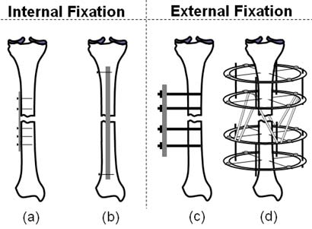
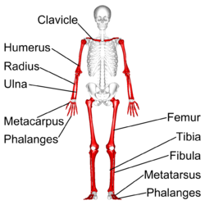
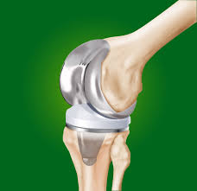
Introduction
Study of musculoskeletal system
Long bones are prone to injury
Internal and external fixation
Joint replacement

Slide 3
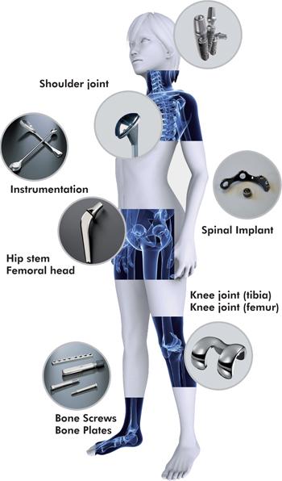
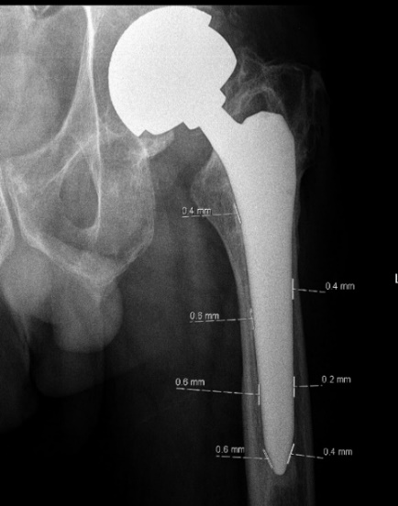
Metals
aseptic loosening
carcinogenesis
Bioactive with porous or coated
Alone in fixation
Combined with others problems
Stainless steel
Cobalt
titanium
Asepric loosening of hip replacement

Slide 4
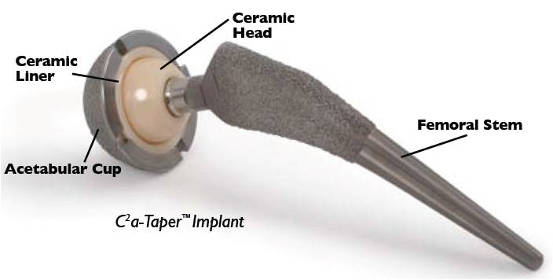
Ceramics
orthopedic surgery
Traumatology
Types : fast , slow resorbing and
injectible
Promote healing of bone
Favourable bioactivity and
interaction with host tissue
natural organ replacement at load-bearing or void-filling sites
(1) hematoma formation, (2) inflammation, (3) neovascularization, (4) osteoclastic resorption, and (5) new bone formation
Ceramic hip joint

Slide 5
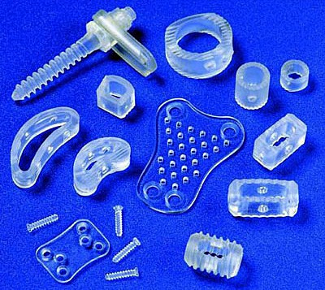
polymers
in fracture fixation
bone replacement
cartilage repair
fixation of ligaments
drug delivery
PLA, PGA, PHBV
Composites
Gene therapy
Bone regeneration

Slide 6
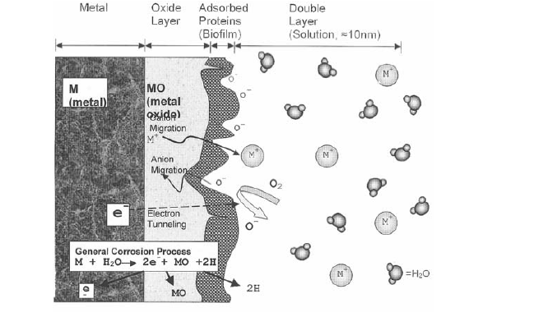
Corrosion and biocompatibility
Thermodynamic considerations
High negative electrode potentials
Formation of metal oxides
Kinetic barriers
Formation of passive film
Compact film covering the metal

Slide 7
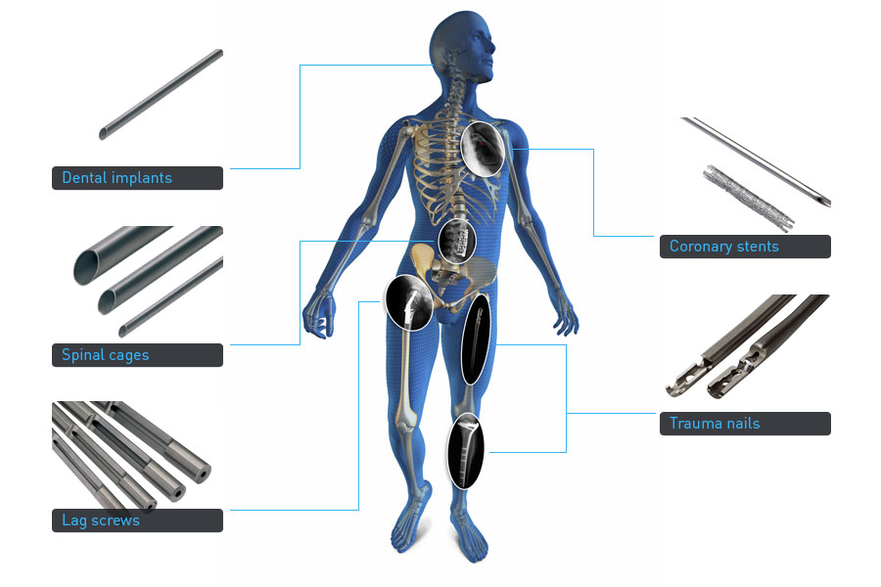
Stainless steel alloys
316LV Stainless steel
Low carbon
Austenitic structure
Growth and thickening of oxide layer
New alloy biodur 108
High nitrogen content
Improved pitting and crevice corrosion

Slide 8
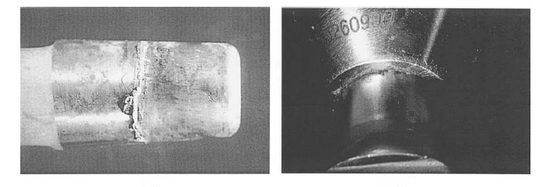
Cobalt chromium alloys
2 types
Without nickel (Co-Cr-Mo)
With nickel (Co-Ni-Cr-Mo)
Increased corrosion resistance
Increased toxicity
Poor frictional properties
Retrieved joint replacement components showing corrosion around the rims of early model
conical taper connections. (a) Cobalt-based alloy stem showing evidence of corrosion precipitates. (b)
Deposits of CrPO4 corrosion products on the rim a modular cobalt–chrome femoral component. Both
fretting and crevice corrosion are responsible for generating this type of implant degradation

Slide 9
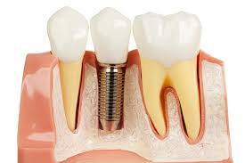
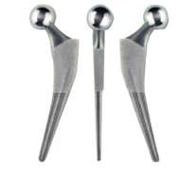
Titanium
CPTi in dental applcations
Ti-6Al-4V in joint replacement
BCC ( beta ) (v 3.5-4.5)
HCP phase (alpha) (Al-5.5-6)
thermomechanical processing treatments
fine-grained HCP phase with a sparse
distribution of the BCC phase.

Slide 10
Titanium
fine-grained HCP phase with a sparse distribution of the BCC phase.
Better pitting, intergranular, and crevice corrosion resistance
strength of Ti-6Al-4V exceeds that of stainless steel
flexural rigidity half of stainless steel and Co–Cr–Mo alloys.
torsional and the axial stiffness (moduli) of Ti alloys closer to bone
provide less stress shielding than do Co alloys and stainless steel
fracture fixation devices (plates, screws)
spinal fixation devices
total hip replacement femoral components.
Used where resistance to wear is a primary concern

Slide 11
Primary mechanism of implant corrosion
observed in the taper connections of retrieved modular joint replacement components
combination of stress and motion at the taper connection
the crevice geometry of the taper
causes significant changes in the metal surface potential and in the crevice solution chemistry
Deration and lowering of pH
loss of the oxide film

Slide 12
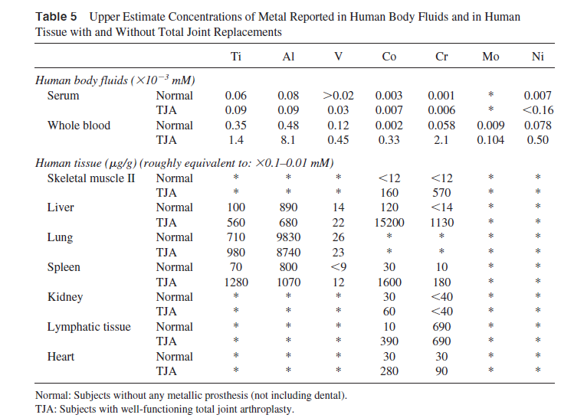
Metal ions/soluble metal levels
Normal human serum levels of
prominent implant metals are
approximately as follows:
1–10 ng/mL aluminum,
0.15 ng/mLchromium,
0.01 ng/mL vanadium,
0.1–0.2 ng/mL cobalt,
4.1 ng/mL titanium

Slide 13
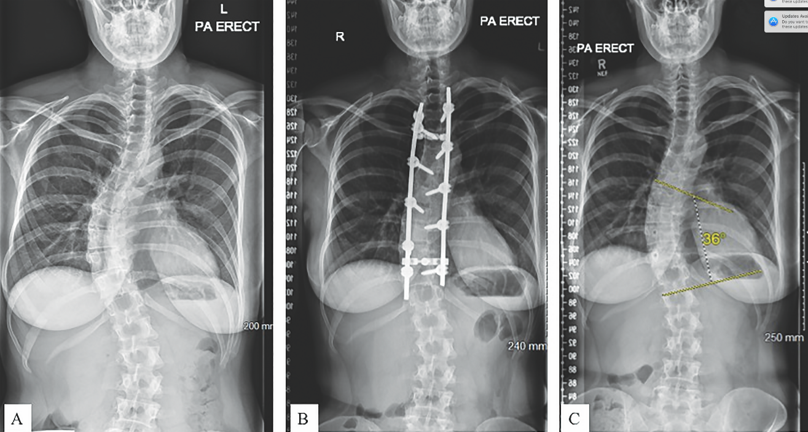
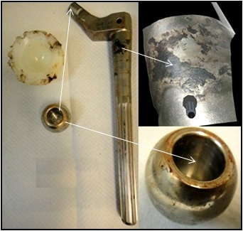
Local effects of implant corrosion
Soluble corrosion debris
Particulate Debris Corrosion
Particulate debris in body because of metal implant corrosion

Slide 14
Biocompatibility tests
Test article preparation is a critical variable in the conduct of the biocompatibility tests
testing medical devices in the condition that they will be used
where differences exist between ,additional information describing how these differences could impact study findings are considered.
Examples:
low-level tissue response
extraction and surface characterization techniques

Slide 15
Testing of In Situ Polymerizing Materials
test article preparation be representative of the device in its final finished form
in vitro degradation methods may be considered with appropriate technical justification
in vitro used for biological testing
in vivo tests for devices, assessment time points would depend on the polymerization and degradation kinetics

Slide 16
Summary
1.metallurgical processing variables
2.tolerances of modular connections
3.surface processing modalities
4.appropriate material selection
significantly reduce the magnitude of fretting corrosion
mechanical-electrochemical interactions of metal surfaces

Slide 17
References
Petek Korkusuz, Feza Korkusuz, Hard Tissue–Biomaterial Interactions. Biomaterials in orthopedics; 10: 1-40
Nadim James Hallab, Robert M. Urban, and Joshua J. Jacobs. Corrosion and Biocompatibility of Orthopedic Implants. Biomaterials in orthopedics; 10: 63-93.
U.S. Department of Health and Human Services, Food and Drug Administration, Center for Devices and Radiological Health. Use of International Standard ISO 10993-1, "Biological evaluation of medical devices - Part 1: Evaluation and testing within a risk management process"

Slide 18
Thank You

